Slide 1
Examples of Magnetic Fields

Slide 2

By now you should be familiar with magnetic fields in bar magnets.
In particular, you should be able to draw the magnetic fields of bar magnets and explain how these fields interact.
Now it's time to learn about some other examples of magnetic fields. In particular, we will look at the magnetic fields of current-carrying wires and solenoids.

Slide 3
By the end of this Smart Lesson, you should be able to:
Understand that current-carrying wires generate magnetic fields.
Describe the shape of the magnetic field of a current-carrying wire.
Apply the right-hand rule to find the direction of magnetic fields.

Slide 4
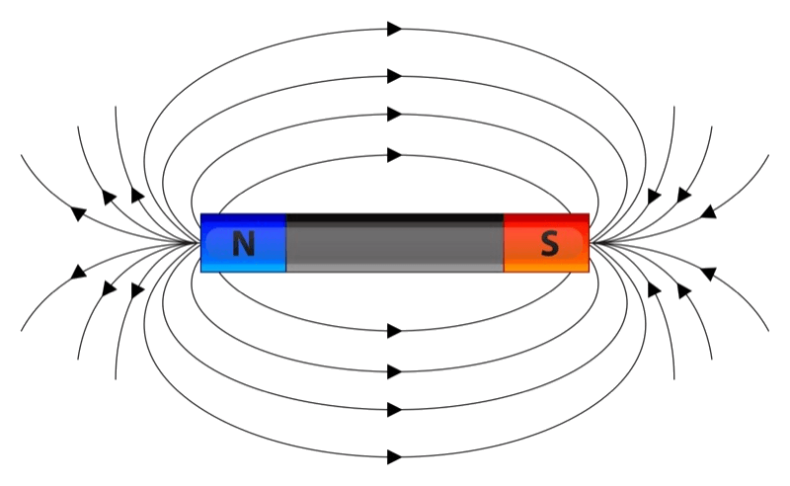
Remember, a magnetic field is a region where a magnetic force can be felt.
We use magnetic flux lines to represent these fields.
Magnetic fields are generally produced by permanent magnets. However, they can also be produced by moving charged particles.

Slide 5

You may already know that charged particles produce electric fields.
When these particles move, they also produce a magnetic field.
You don't need to worry about why this happens. For now, just remember the rule below:
"Moving charged particles produce magnetic fields."

Slide 6
An electric current is made up of many charged particles moving down a wire.
This means that a magnetic field will also form around a current carrying wire.

Slide 7
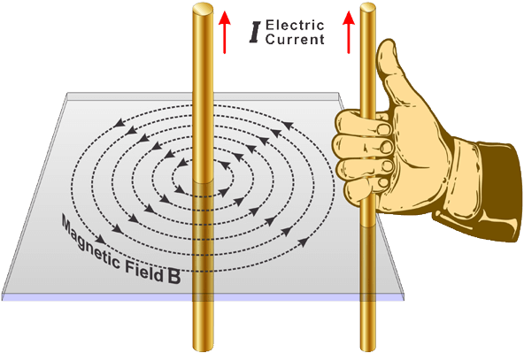
A current carrying wire produces a circular magnetic field.
The magnetic flux lines form a series of circles with the wire at the center.
We can use the right-hand rule to work out the direction of the magnetic field. To do this, you hold your right hand next to the wire and point your thumb in the direction of the current. Your fingers then curl in the direction of the magnetic field.

Slide 8
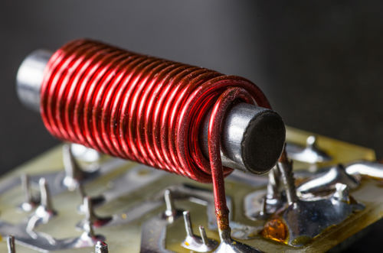
The next magnetic field that we will look at is the one produced by a solenoid.
A solenoid is produced when a current-carrying wire is twisted into a coil.

Slide 9
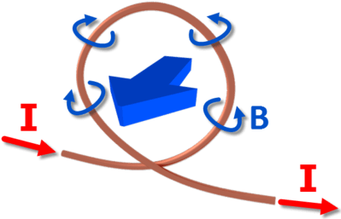
To understand the magnetic field of a solenoid, we need to look at the magnetic field of a single loop of wire first.
Look at the diagram below, which shows a loop of wire with a counter clockwise current. No matter which point you choose on the wire, when you use the right-hand rule you will find that the magnetic field comes out of the screen in the middle of the loop and goes into of the screen on the outside of the loop.
This creates a strong magnetic force going straight through the loop of wire.

Slide 10
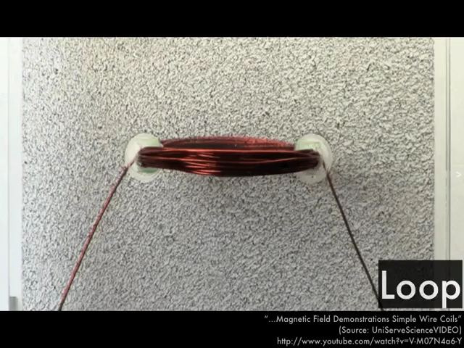
We can think of a solenoid as many loops of wire that are tightly packed together.
The principle of superposition means that the magnetic fields from each loop of wire will interact.

Slide 11
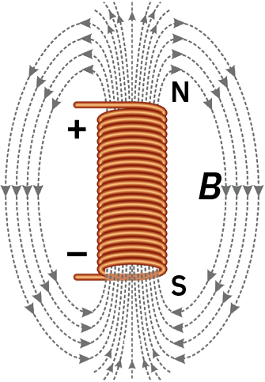
When we have a long solenoid, there is a uniform magnetic field inside the solenoid and a very weak magnetic field outside the solenoid.
The magnetic field inside the solenoid travels parallel to the axis of the solenoid, and is the same at all points within the solenoid. This happens because the magnetic field inside each loop of wire add together while the magnetic fields on the outside mostly cancel each other out.

Slide 12
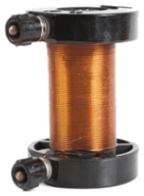
The magnetic field strength of a solenoid depends on three things:
The number of loops.
The length of the solenoid.
The material inside the solenoid.

Slide 13
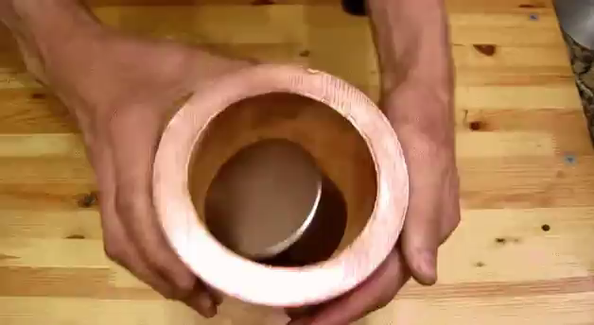
We use this formula to find the magnetic field strength inside the solenoid:
B=μnI
In this formula, n is the number of turns per unit length. This is found by dividing the total number of turns in the solenoid by the length of the solenoid.
I is the current flowing through the solenoid and μ is the magnetic permeability of the material inside the solenoid.
Magnetic permeability is the measure of how easily magnetic fields can form inside materials.

Slide 14

This means that there are three ways to increase the magnetic field strength of a solenoid.
The first way is to increase the number of turns per unit length.
Another way is to increase the current flowing through the solenoid.
Finally, you can increase the magnetic permeability of the material inside the solenoid. For example, iron has a much higher magnetic permeability than air, so most solenoids have an iron core.

